Slide 1
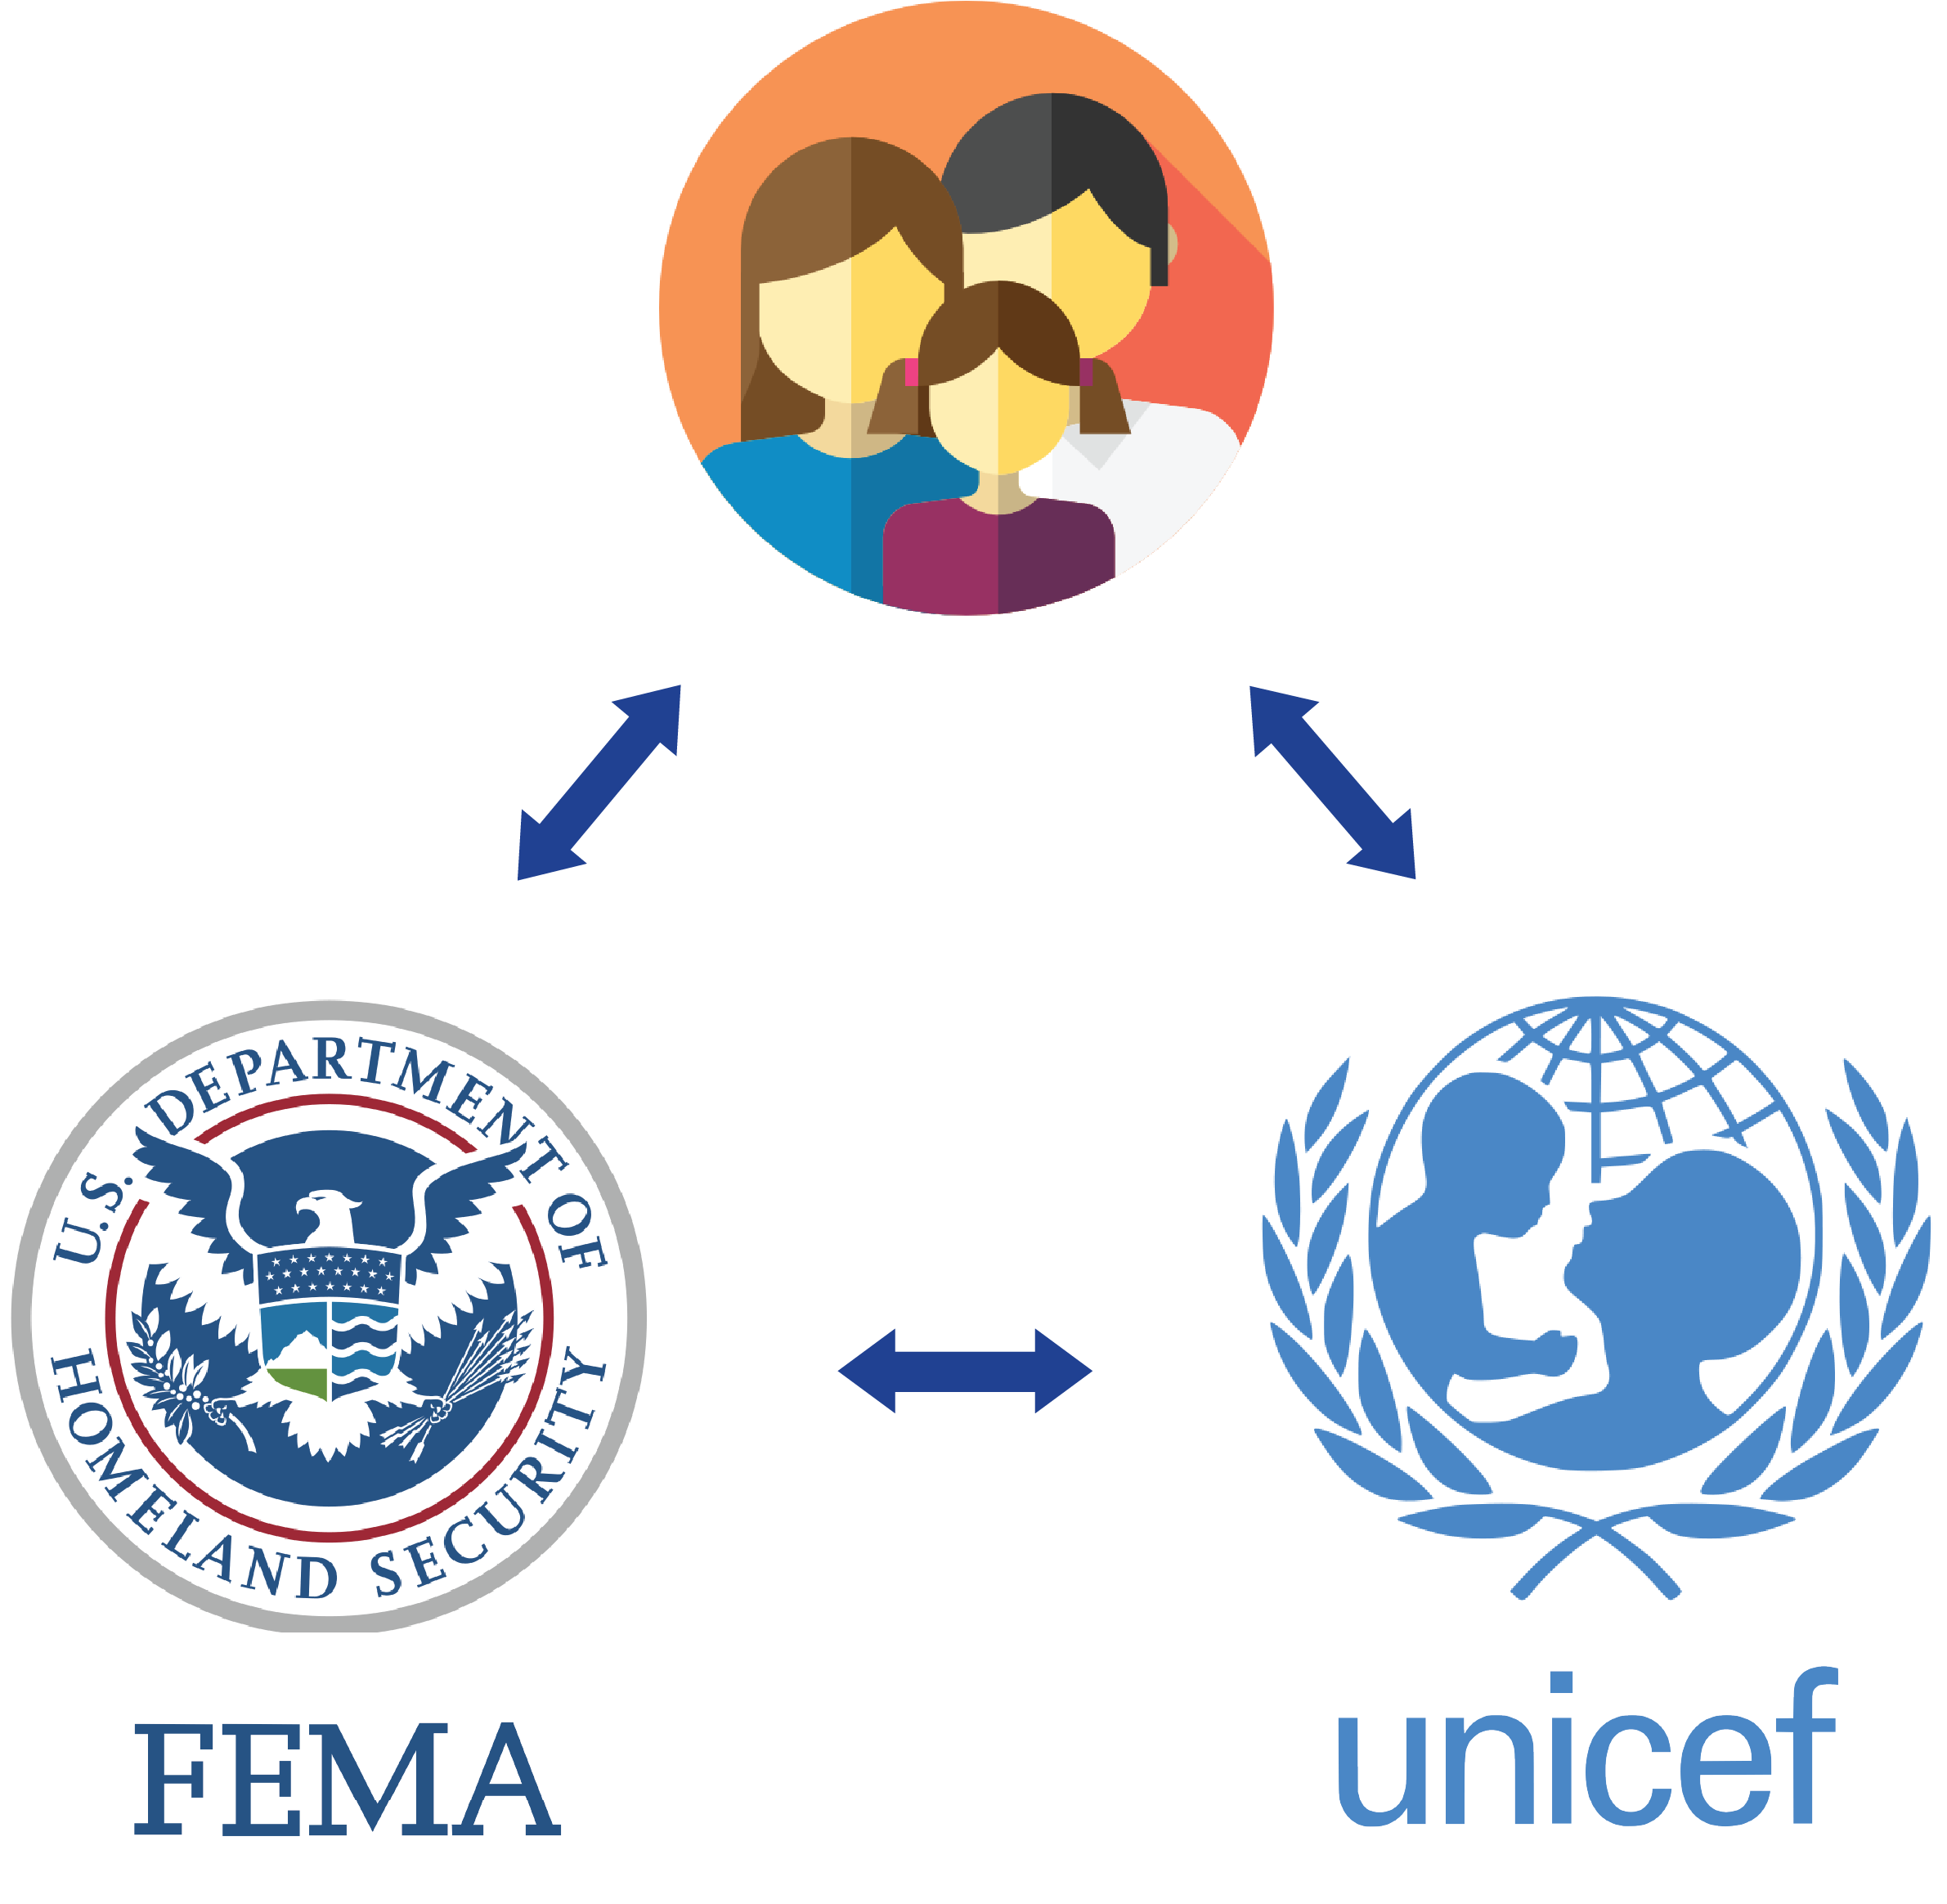
PREPARE
Plan | Provision | Prioritize

Slide 2
Private Citizens
Get Updates
Peace of Mind
Be Prepared

Slide 3
Agencies & NGOs
Reinforce evacuation orders
Identify private shelters
Heatmap of emergency supplies
Connect with citizens via SMS

Slide 4

Private Shelters, Visualized

